Slide 1

6th Grade Math
Unit 3, Lesson 5 Using Operations to Solve Real-World Problems – Part 2 Volume 1, pg. 112

Slide 2


Benchmark
MA.6.NSO.2.3
Solve multi-step, real-world problems involving any of the four operations with positive multi-digit decimals or positive fractions, including mixed numbers.
volume 1, pg. 112

Slide 3
Integrated Mathematical Thinking and Reasoning Standards
MA.K12.MTR.5.1 Use patterns and structure to help understand and connect mathematical concepts.
MA.K12.MTR.7.1 Apply mathematics to real-world contexts.
volume 1, pg. 112

Slide 4

Learning Target
I can solve one-step, real-world problems involving any of the four operations with decimals or fractions.
volume 1, pg. 112

Slide 5

Warm-Up
volume 1, pg. 113

Slide 6
3.5.1 Warm-Up: Two Questions and One Wonder
Ky-ree, a firefighter in Los Angeles, budgets his paycheck.
Ky-ree’s Budget
Monthly salary | $5,800 | Car payment | $330
Taxes and other deductions | $2,900 | Insurance | $120
Net take home income | $2,900 | Gas | $140
Rent | $1,350 | Food | $250
Utilities | $60 | Gym | $30
Internet & cable | $50 | Entertainment | $120
Cell phone | $130 | Remaining | $320
volume 1, pg. 113

Slide 7
List two questions you have about Ky-ree’s budget.
List one thing you wonder about Ky-ree’s budget.
volume 1, pg. 113

Slide 8

Guided Instruction
volume 1, pg. 113

Slide 9
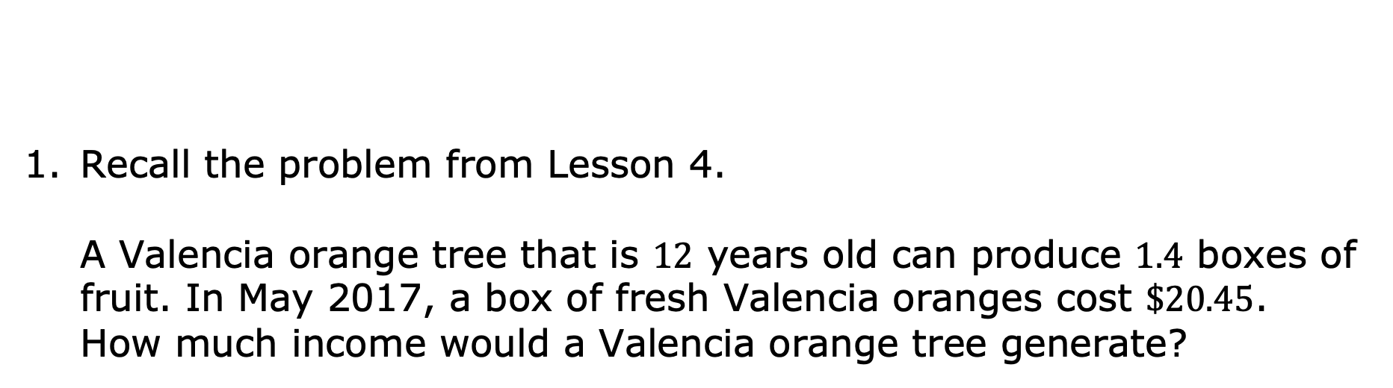
3.5.2 Guided Instruction: Real-World Contexts About Finances
Income is the amount of money received.
Recall the problem from Lesson 4. A Valencia orange tree that is $12$ years old can produce $1.4$ boxes of fruit. In May 2017, a box of fresh Valencia oranges cost $\$20.45$. How much income would a Valencia orange tree generate?
volume 1, pg. 113

Slide 10
Finance is the management of money.
Daniel owns a Valencia orange grove. Choose other items from the list that he should consider as a part of his finances.
The taxes he pays on the property.
The amount of money he has in the bank.
The cost of taking care of the orange grove.
volume 1, pg. 113

Slide 11
Use the words in the word bank to complete each statement.
______________ or _____________ describe money that is spent.
b. ____________ are the amount of money that is paid to the government.
c. A _____________ is the amount of money placed in a bank account.
Word Bank
withdrawal | checking | costs | deposit
expenses | savings | taxes
volume 1, pg. 114

Slide 12
A ____________ is the amount of money removed from a bank account.
_____________ and _____________ are types of bank accounts.
An investment is when the initial amount of money, known as the principal, earns more money, known as the return, over time.
volume 1, pg. 114

Slide 13
For each financial transaction, write the mathematical operation that is most commonly associated with it.
Financial Transaction | Mathematical Operation
costs
deposit
expenses
income
taxes
withdrawal
return on an investment
volume 1, pg. 114

Slide 14

Hannah earns $\$9.17$ an hour. Each week she works $14$ hours. How much is Hannah’s weekly gross income?
Each week Hannah has to pay $\$26.96$ in taxes. What is Hannah’s net income?
Gross income is the amount of income that is earned.
Net income is the amount of income that is earned after expenses and taxes are deducted.
volume 1, pg. 114

Slide 15

Guided Practice
volume 1, pg. 115

Slide 16

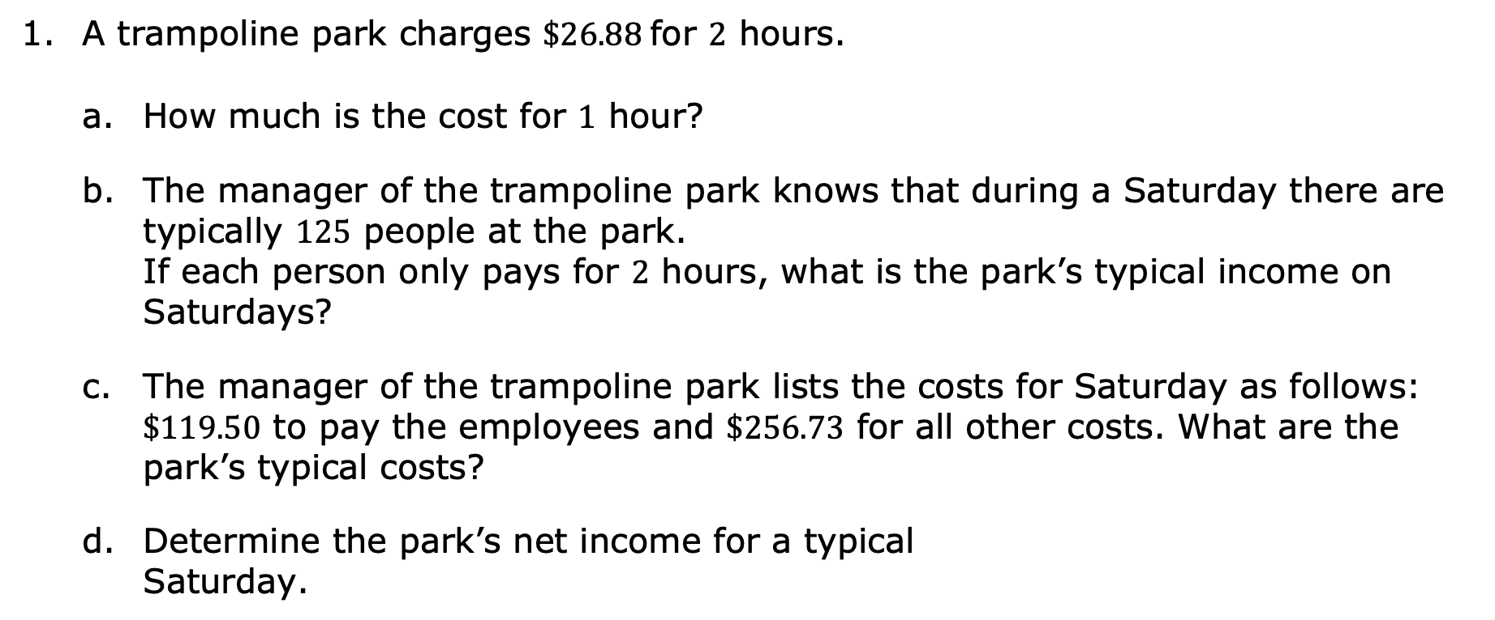
3.5.3 Guided Practice: Solving Real-World Finance Problems
A trampoline park charges $\$26.88$ for $2$ hours.
How much is the cost for $1$ hour?
The manager of the trampoline park knows that during a Saturday there are typically $125$ people at the park. If each person only pays for $2$ hours, what is the park’s typical income on Saturdays?
The manager of the trampoline park lists the costs for Saturday as follows: $\$119.50$ to pay the employees and $\$256.73$ for all other costs. What are the park’s typical costs?
Determine the park’s net income for a typical Saturday.
volume 1, pg. 115

Slide 17
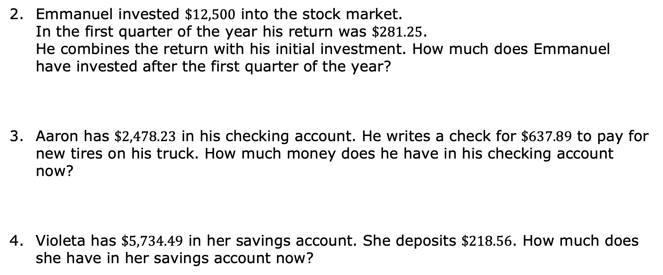
Emmanuel invested $\$12,500$ into the stock market. In the first quarter of the year his return was $\$281.25$. He combines the return with his initial investment. How much does Emmanuel have invested after the first quarter of the year?
Aaron has $\$2,478.23$ in his checking account. He writes a check for $\$637.89$ to pay for new tires on his truck. How much money does he have in his checking account now?
Violeta has $\$5,734.49$ in her savings account. She deposits $\$218.56$. How much does she have in her savings account now?
volume 1, pg. 115

Slide 18

Wrap-Up
volume 1, pg. 116

Slide 19
3.5.4 Wrap-Up: Ticket Out the Door
Mishka is planning to host a music festival to raise funds for a local food bank. Her budget is shown.
In order to find the gross income for the music festival, I need to know _____________________________ and ________________________________________.
Item | Amount
Ticket price at the door | $9.00
Fee paid to each band | $175.00
Early-bird ticket price | $6.50
Equipment rental | $225.00
Publicity (flyers/artwork) | $64.57
Stage rental | $187.50
volume 1, pg. 116

Slide 20

List the items in Mishka’s budget that are expenses.
If Mishka had a gross income of $\$1,166.50$ and expenses totaling $\$827.07$, what is her net income for the music festival?
volume 1, pg. 116

